Slide 1
Read To Succeed.

Slide 2
Read To Succeed session
You will be given a short text to read.
As you read the text, underline or highlight words you don’t know.
Your teacher will ask you questions about what you have just read.
You will then focus on some key vocabulary using a Frayer Vocabulary Model
Questions about the text:
What type of text is it?
What is the purpose of the text?
Who is it aimed at?
What is the main point made by the author?
What words are you not sure about?
What is the message of the text?

Slide 3
Checking vocabulary knowledge

Slide 4
When reading the text:
As you read, highlight the words you don’t know.
Once you have highlighted, read around the word - does this give you a clue as to what it means?
Ask yourself - have you heard this word before? Is there a root word within it that could help?
Ask the person next to you.
Have a look in a dictionary and write the definition beside the word.
Could you replace the word with another and it would still make sense?

Slide 5
Vocabulary grid

Slide 6
Word used in the text or by the teacher | Synonym for this word - means the same | A complex synonym for this word | An antonym for this word – the opposite

Slide 7
Frayer model – lower ability

Slide 9
Frayer model – upper ability

Slide 11
Vocabulary concept model

Slide 12
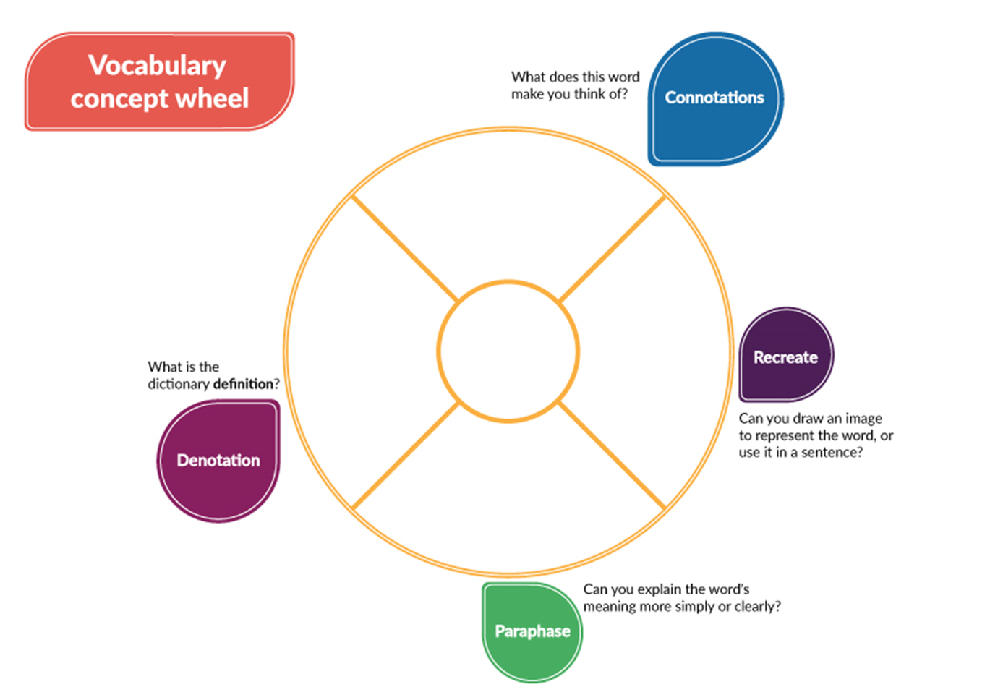

Slide 13
Support for Subjects

