Slide 1
DAB Appeal- Donate Amazing Books
We need AR books!!
If you have any AR books at home you can bring in and donate to the school.
Or go to a charity shop in Leek and purchase are books for you to read then donate. Please mention that you are a student or parent of a student at St Edward’s Academy.
BEFORE you bring them in, please could you go on AR Bookfinder and write the ZPD code and points in the FRONT COVER. That will help us so much.
Bring in your books and donate them in the Mr Jones in Room 201 or to Mrs Iremonger in the library.
Thank you for your generosity!

Slide 2
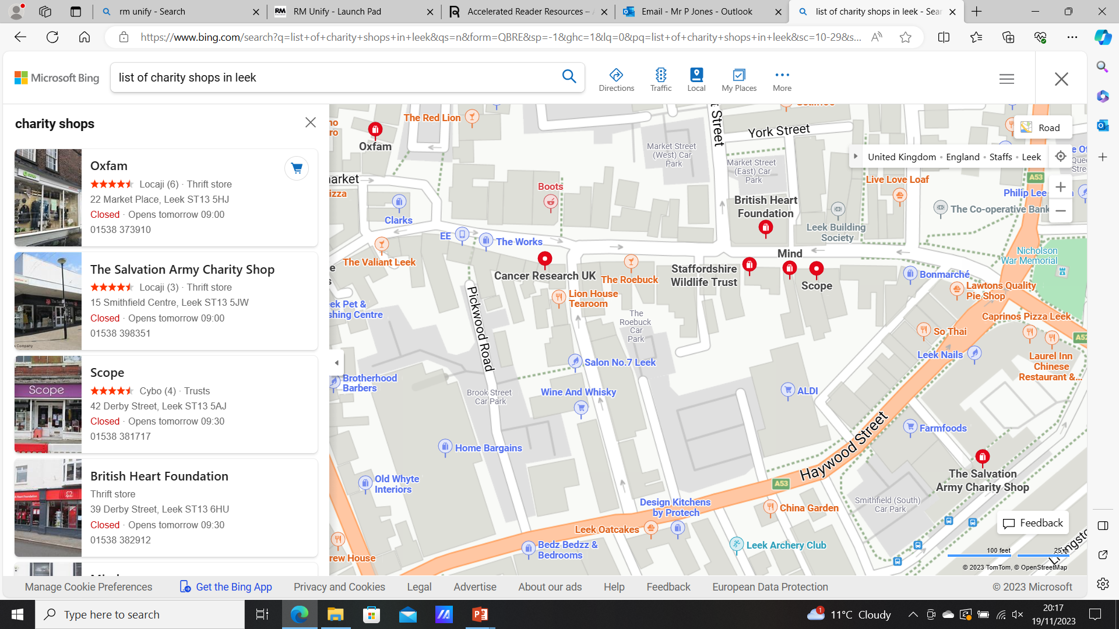
Map of charity shops in Leek

