Slide 1
Accelerated Reader: A Guide for Parents

Slide 2
Accelerated Reader: A Guide for Parents
At St Edward’s Academy all students take part in the Accelerated Reader programme, which is designed to do the following things:
Find books that are the right ability for your child
Encourage your child to read more
Improve your child’s reading ability.

Slide 3
How it works…
At the start of the each term, every student takes a Star Test which is a computer-based test that measures a student’s reading ability through a series of 34 questions.
Every test for every student is different, and the computer selects different questions for each student dependent on how well they answer the previous questions. Essentially, the computer adapts the test to suit your son or daughter.
Once the student has completed the test, they are then given a ZPD score by their teacher.
Notes:
https://ukhosted62.renlearn.co.uk/1892677/default.aspx If they can’t find it

Slide 4
How STAR tests work
The student must take their time. It is recommended that each child should spend at least 20 minutes on their tests. Students are used to working quickly in timed conditions but during a STAR test it is about concentration, focus and careful reading.
Students should not guess answers to questions. Instead, they should wait for the question to time out. This is to ensure the computer is not given a false impression of the student’s reading ability.
Tests are done in exam conditions without any help from other students or the teacher.

Slide 5
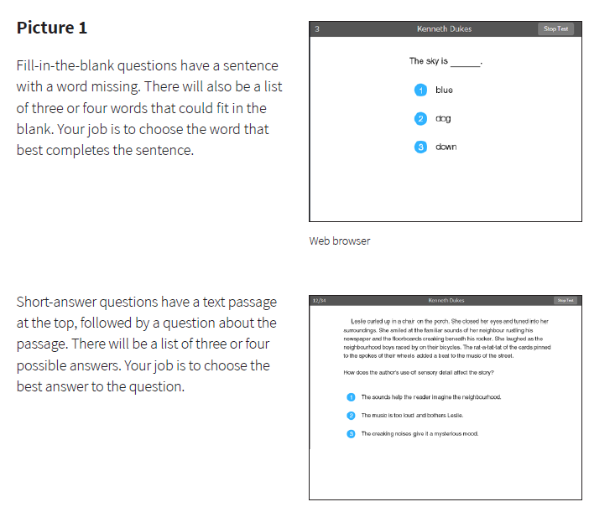

Slide 6
A ZPD score is given to your child after completing the STAR test
3.2 – 4.6
Lowest number
Highest number
ZPD is two numbers that the student uses to choose their next reading book.
The lowest number is the lowest level of book the student should be choosing.
The highest number is the highest level of book the student should be choosing.
Students keep a record of all their ZPDs in their planners or exercise books.
A new STAR test takes place every half term, so students can see improvements in their reading ability, but also choose more challenging books.

Slide 7
AR Colours- ZPD range
 | 0 - 1.9
 | 2 - 2.9
 | 3 - 3.9
 | 4 - 4.9
 | 5 – 5.9
 | 6 – 6.9
 | 7 – 7.9
 | 8 – 8.9
 | 9 – 9.9
 | 10 onwards
Students should only choose books within their numbers and the colours make it easier for them to choose the right book.

Slide 8
AR Quizzes
A quiz is different to a STAR test because students only take a quiz after they have finished a book.
There are usually about 10 questions on the book that has been read. At the end of the quiz the students are given a percentage to show them how well they have done.
There are some important rules for taking quizzes:
The book the child is quizzed on must be a book they have read in the last two weeks. AR is not a memory test but rather measuring reading ability.
A student cannot take a quiz until they have read the entire text.
Quizzes must be done individually, not with anyone’s help.

Slide 9
Feedback
Every two weeks each English teacher has a dedicated AR lesson to work with your child and provide them reading feedback.
The AR lesson with the English teacher will go through how well your child is doing and what they need to do to get better at reading.
English teachers are also there to ensure students are reading the right level and type of books.
The computer can tell teachers very specific information about your child’s reading development. For instance, it can even explain how many minutes a day your child is reading.

Slide 10
“How much should my child read each day?”
According to Renaissance Learning’s research, children who read at least 20 minutes a day with a 90% comprehension rate on AR quizzes see the greatest gains.
Therefore, your child should have at least 20 minutes set aside for reading during day.
English teachers set reading homework on top of the other English homework they set.

Slide 11
“How can I help?”
As with anything, performance improves with practice.
Encourage your child to read at home.
Create a culture of reading in your household by reading with your child, starting a home library, visiting your local library, charity shop or bookshop on a regular basis and by letting your child see you reading.
When reading with your child stop and ask questions to be sure your child comprehends what they have read and in general make a habit of discussing books that each of you has read.

Slide 12
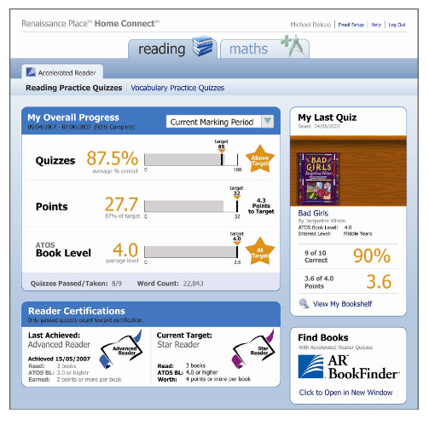
How will I know how my child is doing?
You can access your child’s AR information in Renaissance Place Home Connect from any web-enabled computer.
Once in the programme, you can view your child’s progress towards targets, points and books read.
You can also access AR BookFinder to search for titles of interest.
You can only access information about your own child.

Slide 13
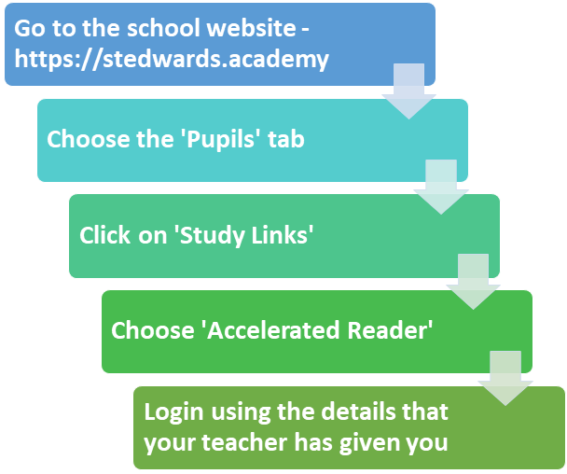
How to log into Accelerated Reader

Slide 14
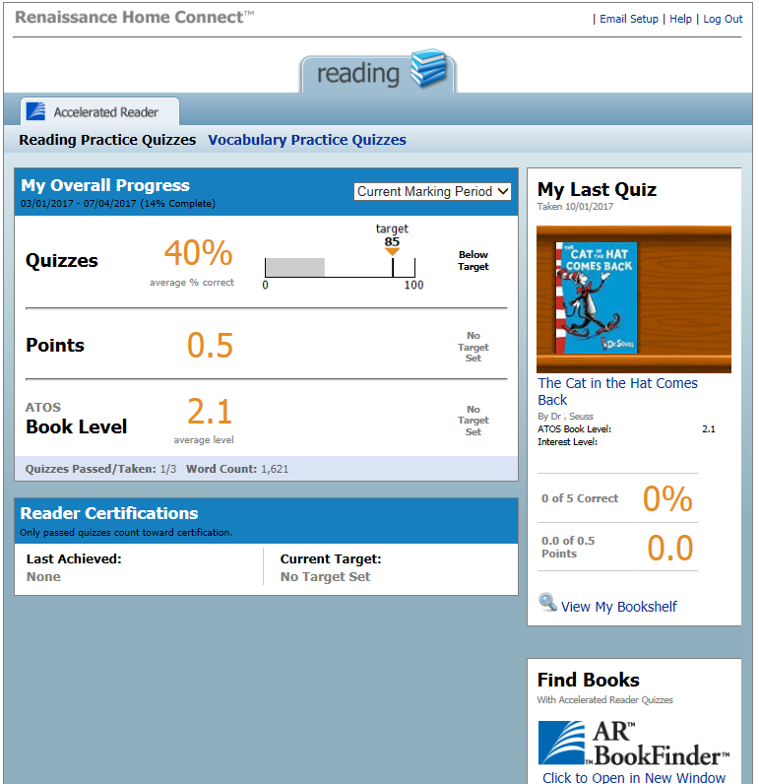
Average quiz score
Points earned
Average book level.
Last book read and quizzed on. Include % correct and points earned from book.

Slide 15
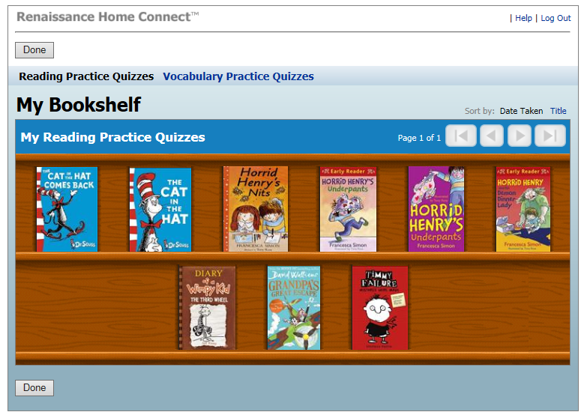
Your child’s bookshelf

Slide 16
AR BookFinder.co.uk
It’s not just books from the Academy that students can read, they can read books from home and take quizzes on them!
You can use ARBookFinder.co.uk to check whether your child’s current book is on Accelerated Reader.

Slide 17
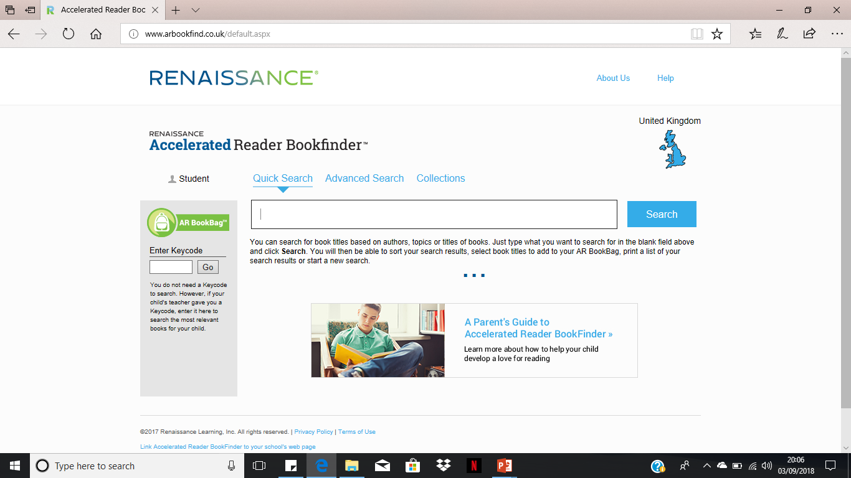
AR Bookfinder

Slide 18
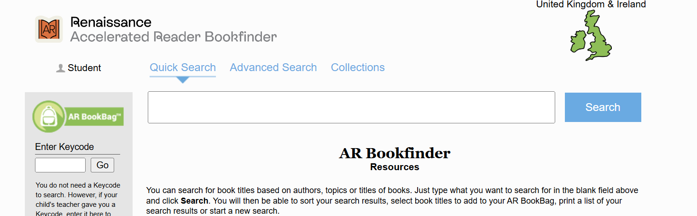
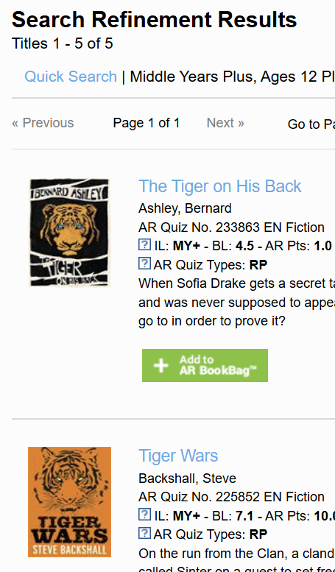
Quick Search in Accelerated Reader Bookfinder
Quick Search allows you to use keywords to search for matching book and article titles, authors or topics.
Select Quick Search.
2. Type a book title, author's name, keyword or topic into the blank field.
3. Select Search.
4. The Search Results page will open.

Slide 19
Can a child who is not a strong reader still use Accelerated Reader?
Accelerated Reader helps all children become better readers from pupil, regardless of initial ability.
When children read books at their appropriate level, they experience success.
Furthermore, teachers work with children to set appropriate targets based on each child’s reading level.

